Slide 1
IEO – week 3

Slide 2
This week
How data is stored in computers?
How does a computer handle negative numbers?
Notes:
Applies to al electronic devices?

Slide 3
Memory
Computer Data Storage

Slide 4
Storage/Memory
Fundamental component of a computer
Required to store data and run applications
Retain digital data, which are manipulated by CPU
Various types and forms
Consists of computer components and recording media

Slide 5
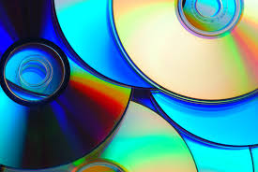
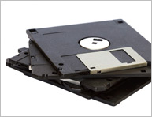
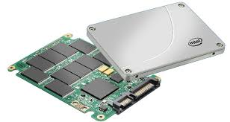
Storage types & medium
Optical
CD
DVD
Blu-Ray …
Magnetic
Floppy
Hard Drives …
Flash Memory
SSD
Memory sticks/cards …
Notes:
Image: http://www.pcworld.com/article/2106260/sony-panasonic-develop-300gb-optical-discs-for-enterprise-storage.html

Slide 6
Memory types
Disk (permanent, slow, cheap)
RAM memory (volatile, fast)
Cache (volatile, very fast)
Flash, (permanent, expensive)
Clouds *
Most computers and cloud solutions use a combination of those types
Notes:
* For Clouds the internet connection is needed

Slide 7
CPU Cache
CPU cache:
L1: fastest, smallest, close to the CPU
L2: slower and larger than L1
(L3: slower and larger than L2)
CPU first checks L1 for data, then L2(, then L3), then RAM memory, then drive
CPU
Level 1
cache
Level 2
cache
System RAM
Hard disk

Slide 8
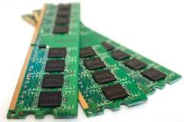
(S/D)RAM
SRAM and DRAM
DRAM (Dynamic RAM is cheap (one transistor per bit) but needs refreshing
SDRAM is a special form of DRAM that is synchronized with the clock. DDR2, DDR3 and DDR4 are examples of DRAM
SRAM (Static RAM) needs no refreshing, but expensive (more transistors per bit)
Usually
main memory is DRAM
cache memory is SRAM.
Notes:
Random Access Memory
Image: http://electronics.howstuffworks.com/how-to-tech/add-ram-laptop1.htm

Slide 9
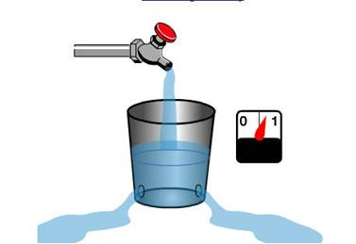
Refreshing?
Every bit is like a bucket with a hole:
When there is water in the bucket: 1
When bucket is empty: 0
After some time, all buckets are empty, to avoid this you have to refresh:
Before the bucket can be empty, check if there is any water in it
if yes, refill the bucket.
Notes:
With refreshing you can think of a bucked with holes
Depletes over time -> to keep info need to refresh
This also means DRAM uses ‘more’ power

Slide 10
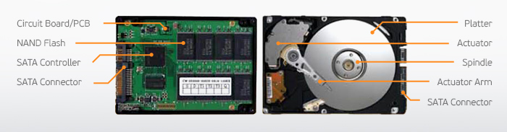
SSD &(vs) HDD
SSD: no overhead of moving mechanical parts, so faster (seek time less than 0,1 msec)
Uses flash memory
Silent
Consumes less power
Lighter
Disadvantage: write-access slows over time
Assume 6000 rpm, seek time 6 msec, 1000 sectors per track
1 rotation takes 60/6000 sec = 10 msec
Waiting for the sector takes on average 1/2 rotation: 60/6000/2 msec = 5 msec
6+5 = 11 msec before reading starts
Reading 1 sector: 10/1000 = 0.01 msec (negligible).
HDD: consists of 1 or more platters
Each platter side covered with magnetic medium
Magnetised/read by ‘read/write’ heads
Permanent or removable.
The total number of tracks on a disk is: (number of tracks on one side) * (number of sides)
The total number of sectors is: (total number of tracks) * (number of sectors per track)
The total number of bytes is: (total number of sectors) * (number of bytes per sector).
In order to read a certain sector, the disk drive must:
position the read/write head on the right track (seek time, usually takes some msec)
wait for the sector to pass under the read/write head (latency, takes on average ½ rotation)
read the sector (takes the time for 1 sector to pass under the read/write head, negligible)
Total time = seek time + ½ rotation.

Slide 11
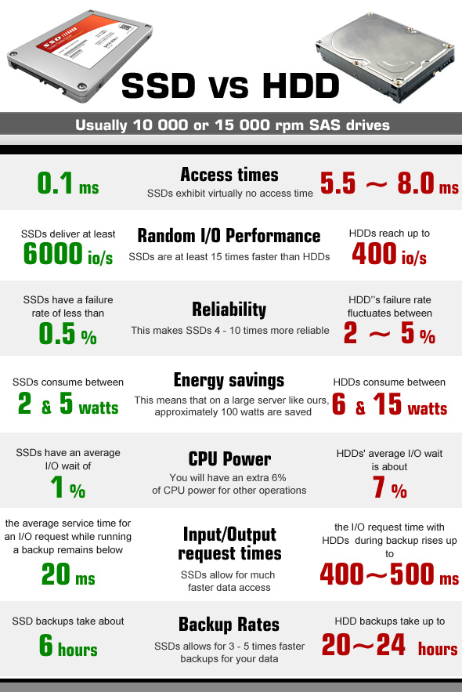
SSD vs HDD performance comparison example in cloud storage
Notes:
Image: http://technofaq.org/posts/2014/11/ssd-hosting-or-hdd-hosting-which-one-to-choose/

Slide 12
Negative numbers

Slide 13
Binary numbers
Normal binary numbers are always positive!
But what about this C# code?
01 int number;
02
03 number = 125;
04 number = -361;

Slide 14
Negative numbers in binary
int number = -231;
Possible by 2’s complement
Now we have 2 types of binary numbers:
unsigned or normal binary
only positive numbers possible
signed or 2’s complement
positive and negative numbers possible

Slide 15

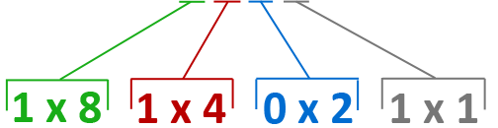

What does signed mean?

Slide 16
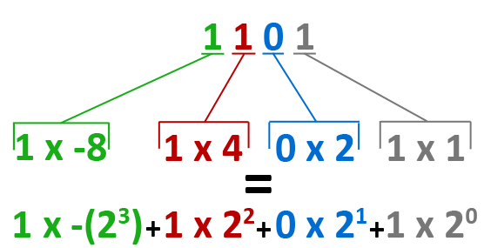
What does signed mean?
Changes to:
Notes:
Most left bit

Slide 17
Rules for signed binary
Amount of bits must be known
Left bit (MSB) gets negative weight
Rest of bits have a positive weight

Slide 18

Signed binary
Digits: 0 & 1
Base: 2
Weight of a most left digit: -( 2 ^{P(osition)} )
Weight of rest of the digits: 2 ^{P(osition)}
Range of values: (-2 ^{(n-1)}) ~ (2 ^{(n-1)} - 1)
Notes:
Byte: -128 ~ 127
P: position
N: number of digits

Slide 19
Signed binary to decimal
Summation of digits x weight factor
Signed 4 bits number: 1101₂
Result: -3₁₀
1 |  | 1 |  | 0 |  | 1
1 x -(2³) | + | 1 x 2² | + | 0 x 2¹ | + | 1 x 2⁰
1 x -8 | + | 1 x 4 | + | 0 x 2 | + | 1 x 1
-8 | + | 4 | + | 0 | + | 1

Slide 20
Decimal to signed binary
Depends on the decimal value!
If positive:
Same as unsigned/nomal binary, but make sure it has the required bits
If negative:
Take the positive value
Convert to binary
Invert all the bits
Add 1

Slide 21
Positive decimal to signed binary
To signed byte
Decimal number: 29₁₀
Result: 00011101₂
1. Convert to binary: | 29 / 2 = 14, remainder 1 14 / 2 = 7, remainder 0 7 / 2 = 3, remainder 1 3 / 2 = 1, remainder 1 1 / 2 = 0, remainder 1
2. Prepend 0 till the required bits | 000 11101
Right
Left

Slide 22
Negative decimal to signed binary
To signed byte
Decimal number: -29₁₀
Result: 11100011₂
1. Make it positive: | 29
2. Convert to binary: | 0 0 0 1 1 1 0 1
3. Invert bits: | 1 1 1 0 0 0 1 0
4. Add 1 | 1 1 1 0 0 0 1 0 0 0 0 0 0 0 0 1 + 1 1 1 0 0 0 1 1

Slide 23
Recap
Convert signed binary to decimal
Most left bit(MSB) has negative weight factor
Convert decimal to signed binary
If positive:
Same as unsigned / nomal binary, but make sure it has the required bits
If negative:
Take the positive value
Write it binary
Invert all the bits
Add 1

Slide 24
Exercise
Convert signed byte to decimal
1111 1111₂
0010 0101₂
1000 1110₂
Convert decimal to signed byte
-40₁₀
5₁₀
-53₁₀

Slide 25
Awnsers
Convert signed byte to decimal
1111 1111₂ = -1₁₀
0010 0101₂ = 37₁₀
1000 1110₂ = -114 ₀
Convert decimal to signed byte
-40₁₀ = 1101 1000₂
5₁₀ = 0000 0101₂
-53₁₀ = 1100 1011₂

Slide 26
Addition with signed binary
Same as unsigned/normal binary numbers
Unsigned
1011 + 111:
Signed (4bits)
1011 + 0111:
1 | 1 | 1 | 1
 | 1 | 0 | 1 | 1
 |  | 1 | 1 | 1 | +
1 | 0 | 0 | 1 | 0
← Carry bits
1 | 1 | 1 | 1
 | 1 | 0 | 1 | 1
 | 0 | 1 | 1 | 1 | +
 | 0 | 0 | 1 | 0
← Carry bits

Slide 27
Huh, ignore stuff?
Reason:
Signed binary has a specific bit count
Consequence:
Calculated result can be wrong
1 | 1 | 1 | 1
 | 1 | 0 | 1 | 1 |  | (-5)
 | 0 | 1 | 1 | 1 | + | (7)
 | 0 | 0 | 1 | 0 |  | (2)
1
 | 1 | 0 | 0 | 0 |  | (-8)
 | 1 | 0 | 0 | 0 | + | (-8)
 | 0 | 0 | 0 | 0 |  | (0)
 | 1 | 1
 | 0 | 1 | 1 | 1 |  | (7)
 | 0 | 0 | 1 | 0 | + | (2)
 | 1 | 0 | 0 | 1 |  | (-7)
← Carry bits
← Carry bits
← Carry bits
Notes:
Side note: If the calculated result doens’t fit it’s called overflow

Slide 28

Questions?

